Slide 1
Machine Vision
Stará turá
2017
MADE BY:
Jakub Perička
Radovan Peter

Slide 2
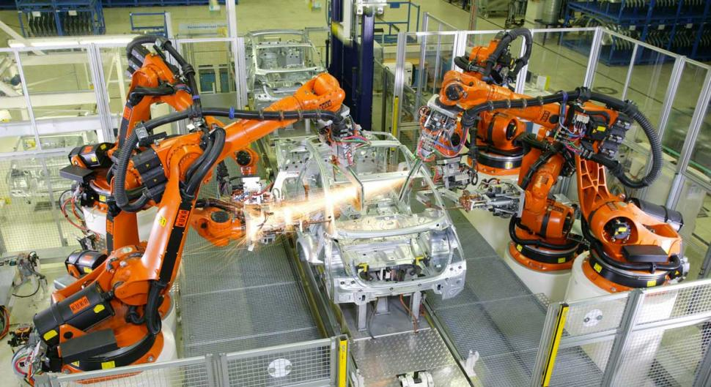
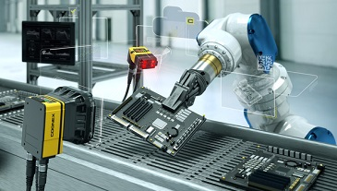
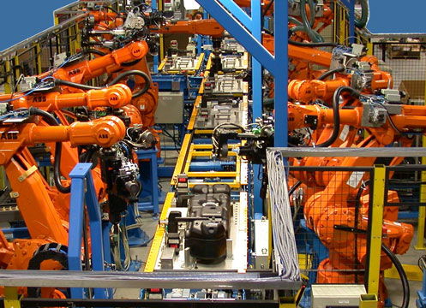
Modern Industry

Slide 3
Requirements
People:
Creative
Skilled
Logical
Practical

Slide 4
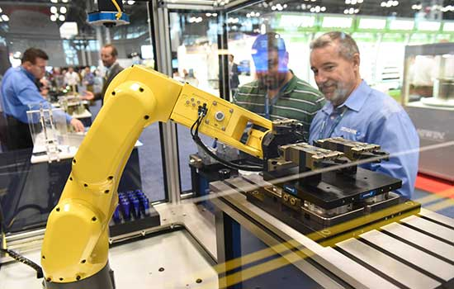
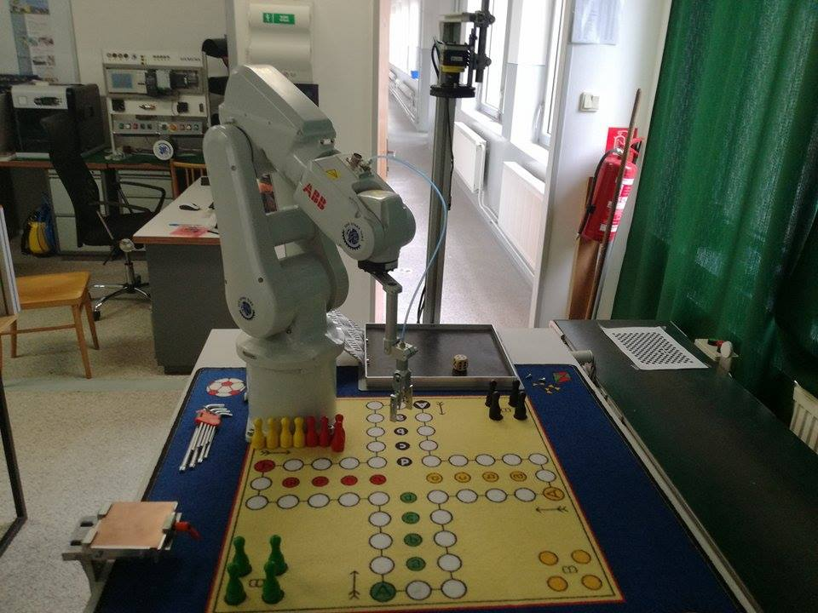
PROJECT idea
Give students of Secondary schools a new, interesting entertaining way of training
Impress and teach practically

Slide 5
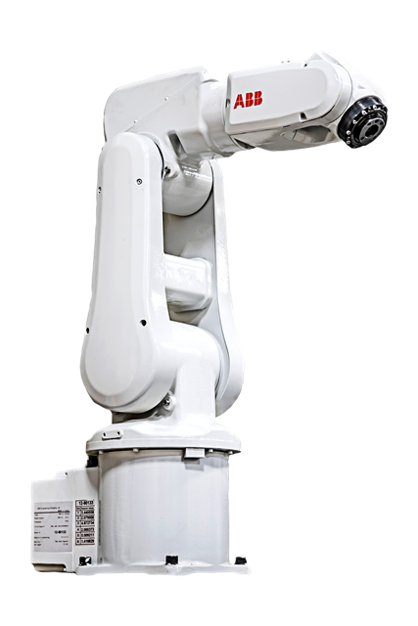
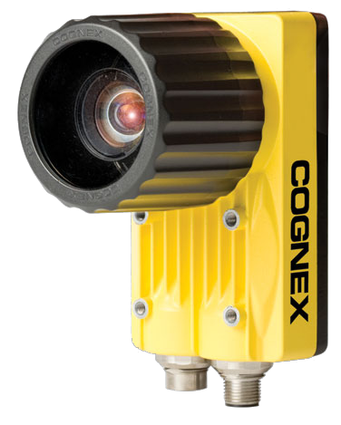
HOW?
Robot
Camera

Slide 6
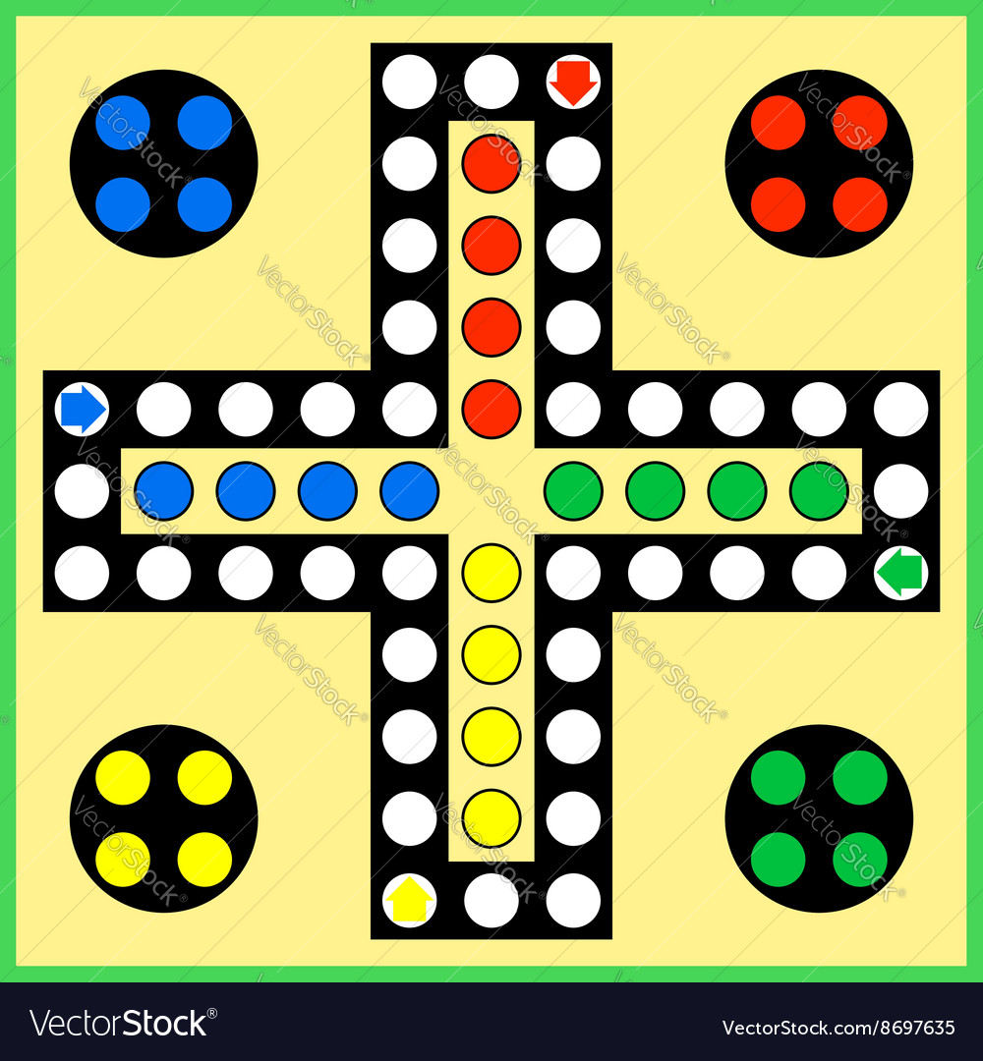
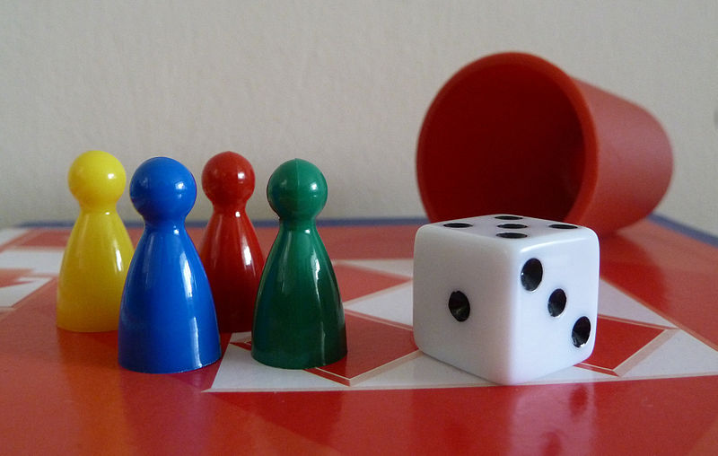
Game
„Ludo“ in English
4 tokens each player
Yard and home

Slide 8
Cognex in-sight explorer

Slide 9
It‘s not the end!

Slide 10
Any questions?

